Slide 1
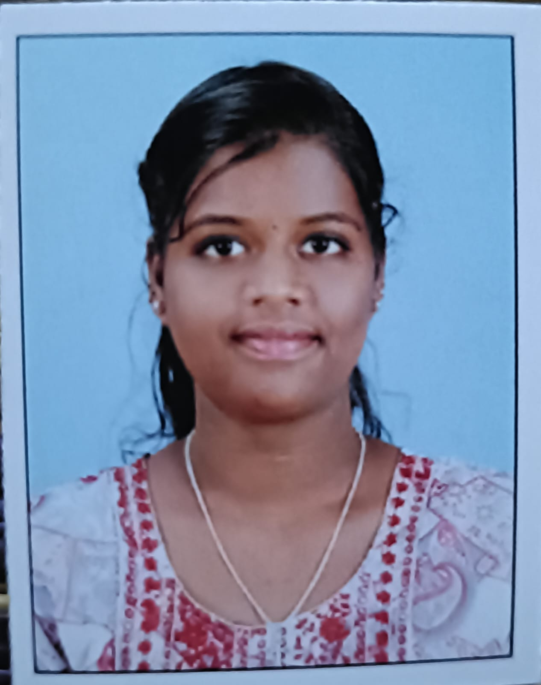
About us
I am Anitha grace .A I am studying in
Bsc(IT) in SNMV College of arts and science
Its located by Malumichampatti,
Coimbatore-641001

Slide 2
Education
Government higher secondary school,vellalore,Coimbatore-641001
My career was developed by a Government higher secondary school in before march 2024.
There is a lot of emotion in my studies period.
Then my 10th,11th,12th, education are completed in 2024.

Slide 3
SKILLS
Debugger
Programmer
Problem solver
Easy to understand programs

